Slide 1
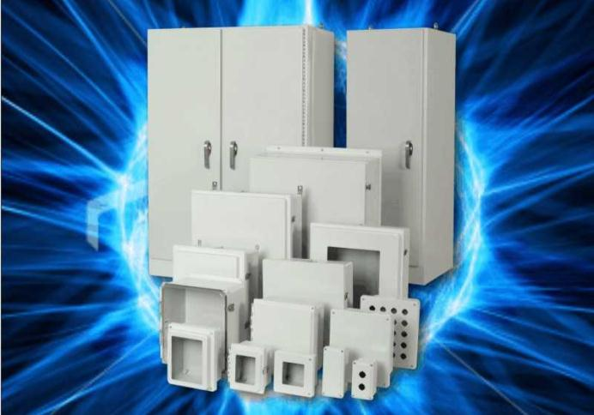
Allied Moulded Enclosure Products.
Non-Metallic Enclosures

Slide 2
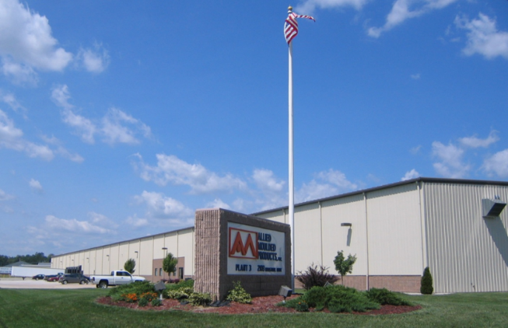
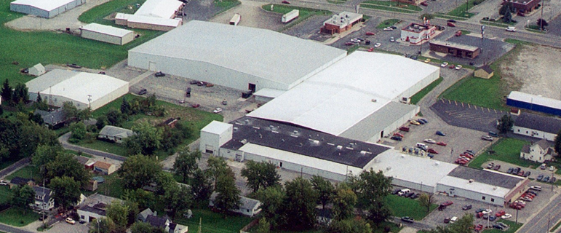
OUR COMPANY: CORPORATE
Founded in 1958 – over 55 years experience in fiberglass manufacturing.
Solid earnings growth and financial stability.
Allied Moulded Enclosure Products (India) Private Limited, formed in 2010, which is wholly owned subsidiary of Allied Moulded Products, Inc.
Leader in the Markets We Play

Slide 3
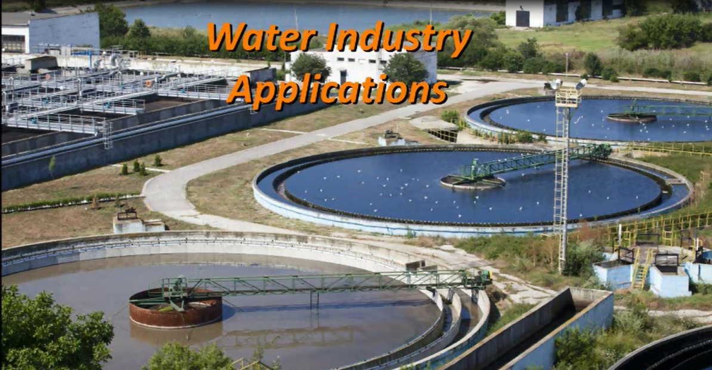
ALLIED INDIA ADVANTAGE
ISO 9001:2008, 42,000 sq. ft. state of the art facility based at Jigani, Bangalore.
Allied India designed to manufacture UL, NEMA, IEC, CE range of product lines.
Dedicated team of 25+ committed to deliver – Highest quality, service and value addition to our customers.
Solar & Wind
Applications
Highly Committed Team with Industry Expertise

Slide 4
ATTRIBUTES: “WHAT WE STAND FOR”
FORWARD-THINKING
COLLABORATIVE
INVENTIVE
DISCIPLINED
Drive Customer Centricity: Think WIN-WIN

Slide 5
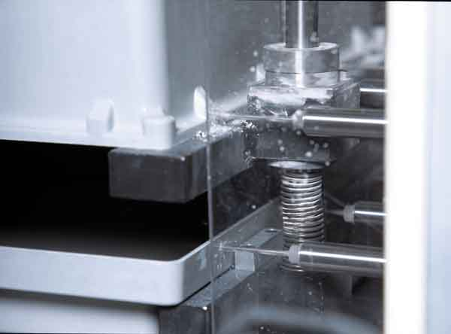
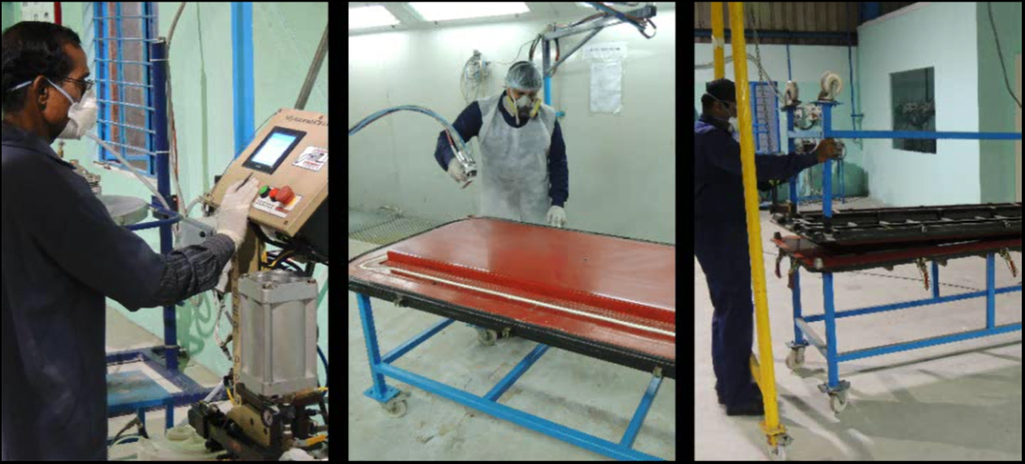
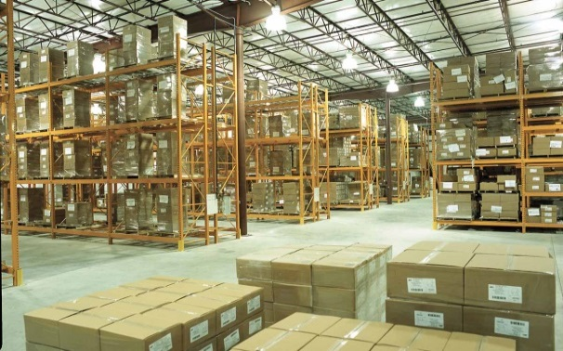
EXPERIENCED MANUFACTURING
Onsite molding, assembly, warehousing.
Safety and Quality are manufacturing culture.
Focus and drive “SPEEDY DELIVERY MODEL”
One-stop shop for all fiberglass enclosure & accessory needs.
Customer First: Safety, Quality & Delivery.

Slide 6
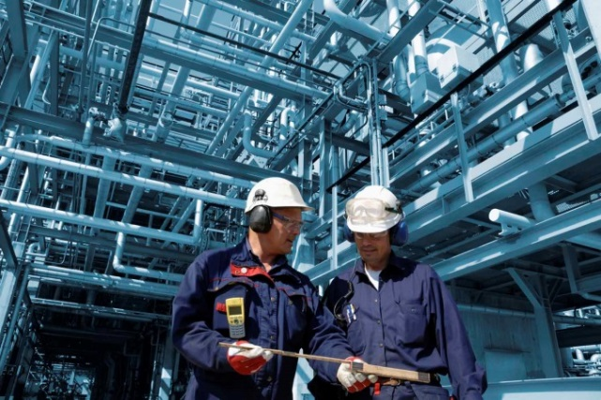
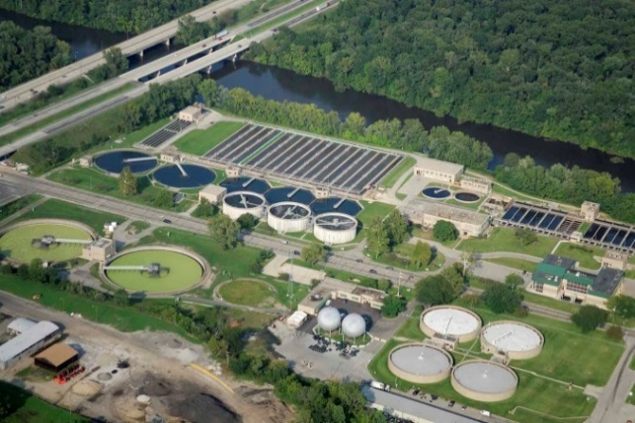
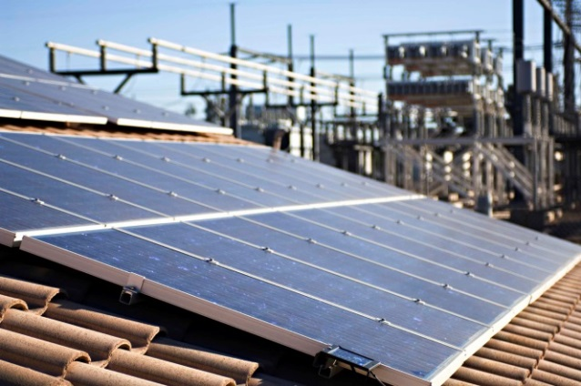
MARKETS WE PLAY
Traditional Markets:
Power Generation and Distribution.
Process & Manufacturing Industries.
Infrastructure.
Emerging Markets:
Solar & Wind.
Oil-Gas-Petrochemical.
Telecommunications & Digital.
Application Driven Product Positioning

Slide 7
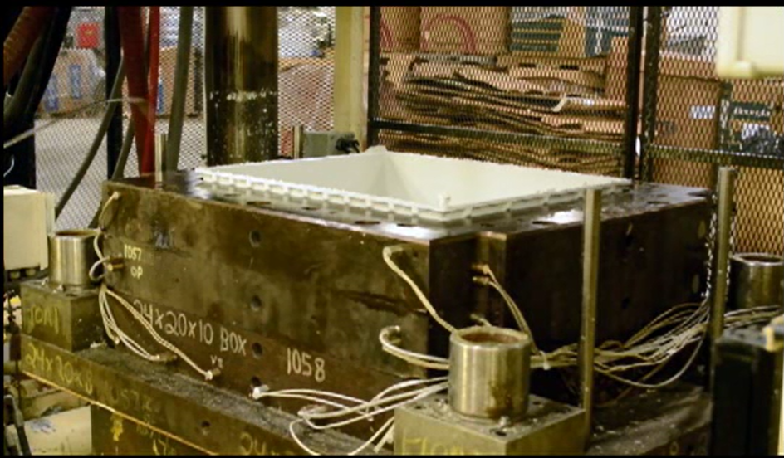
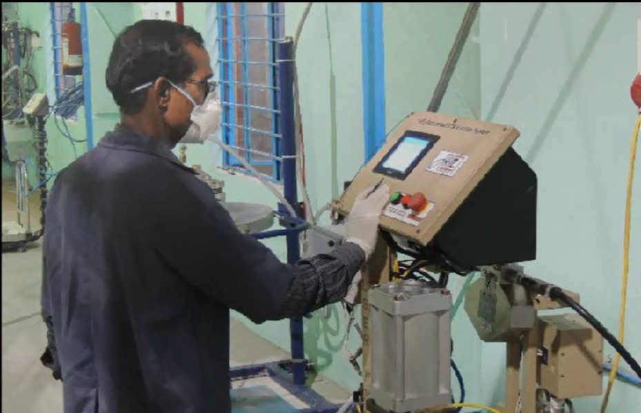
TECHNICAL CAPABILITIES
In-House Lab to test hose down, Conduit pullout etc.
UL and CSA approved facility.
Equipped to perform basic material testing.
Resin Transfer Molding & Hand-Layup.
Compression Molding capability up to 400T.
Custom Modifications :CNC Smart drill.
Build to Print.
Product and Process Expertise Drives Customer Value

Slide 8
REASERCH & DEVELOPMENT: GLOBAL TEAM
12 Full-Time Engineers, all cross trained to support three core functions.
9 CAD Operators experienced on a wide variety of design software programs.
Several external partners for SLA and other rapid prototyping needs.
New Product
Development
Machines &
Processing
Tool & Die
Design
Customer Driven New Products & New Technologies

Slide 9
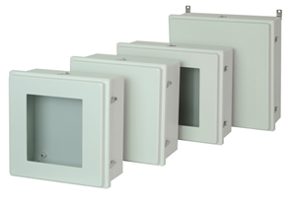
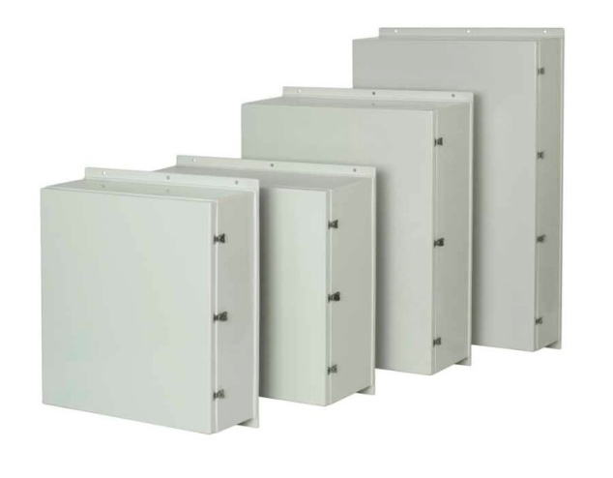
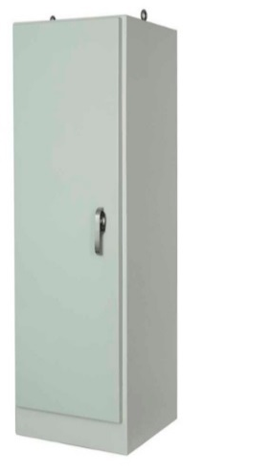
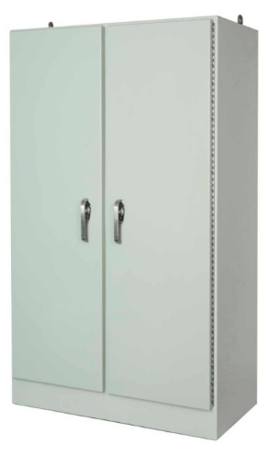
MANUFACTURING FOCUS
Control Series
JIC Series
Empire Wallmount
Empire Free Standing
Listen, Listen, Listen…Our Customer Needs & Requirements

Slide 10
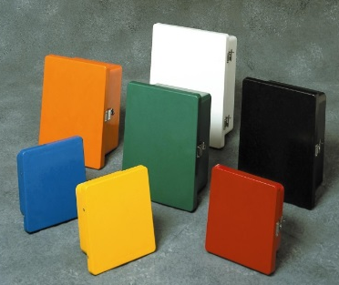
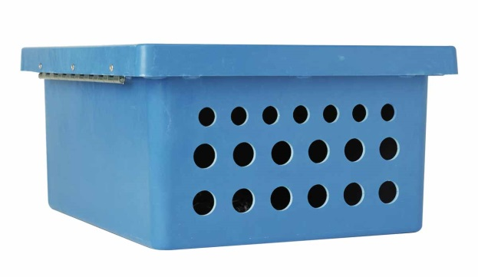
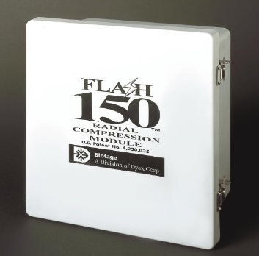
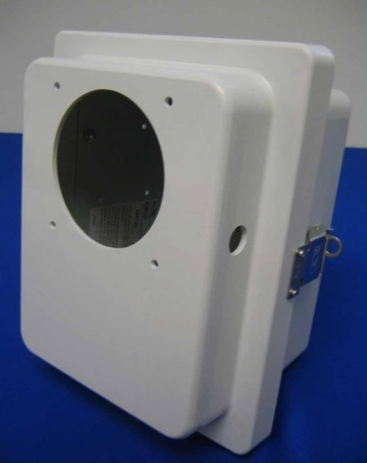
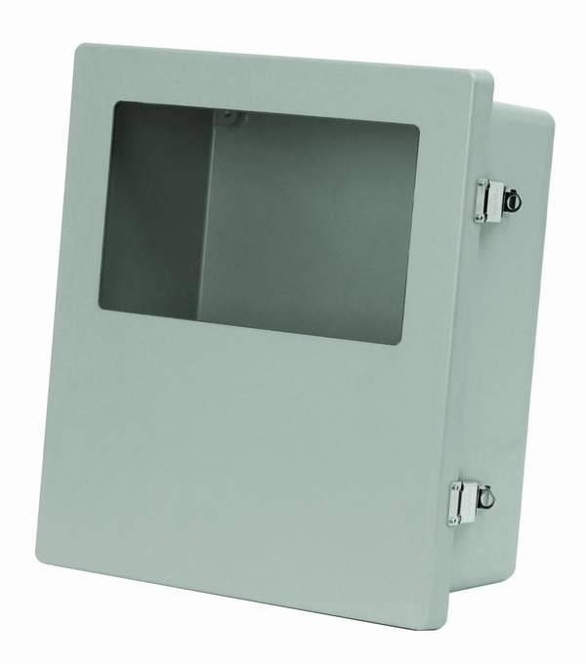
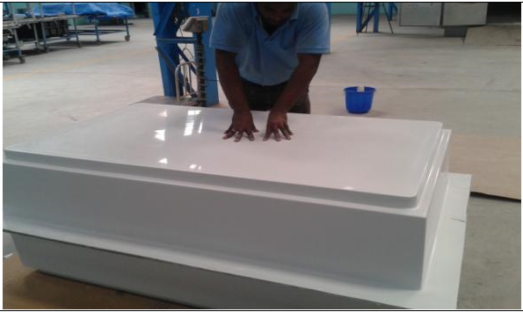
CUSTOMIZATION-TO-BUILD TO PRINT
Listen, Listen, Listen…Our Customer Wins, Its why we Exist

Slide 11
“A customer is the most important visitor on our premises. He is not dependent on us. We are dependent on him. He is not an interruption in our work. He is the purpose of it. He is not an outsider in our business. He is part of it. We are not doing him a favor by serving him. He is doing us a favor by giving us an opportunity to do so.”
- Mahatma Gandhi

Slide 12
THANK YOU
www.alliedmoulded.in

